Slide 1
Handle failed constructor

Slide 2
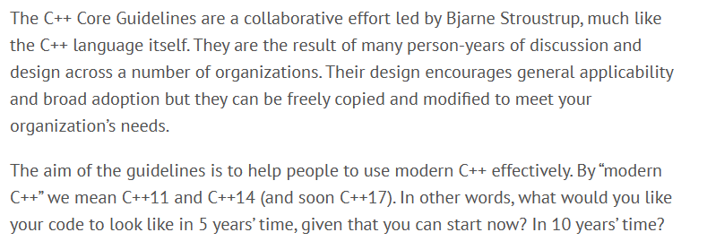
C++ Core Guidelines
C++ Core Guidelines (isocpp.github.io)

Slide 3
Handle failed constructor
C++ Core Guidelines (isocpp.github.io)

Slide 4
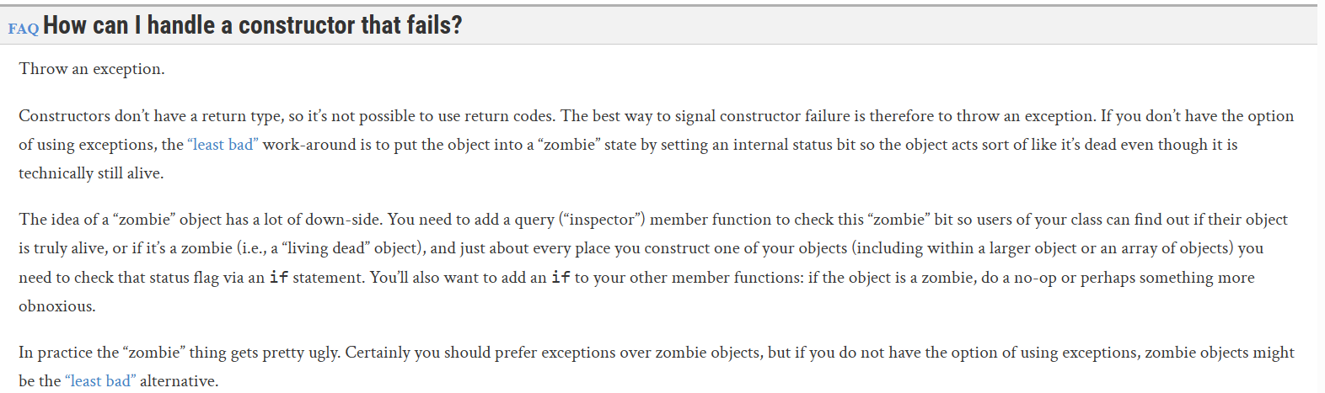
Extra explanation
Exceptions and Error Handling, C++ FAQ (isocpp.org)

Slide 5

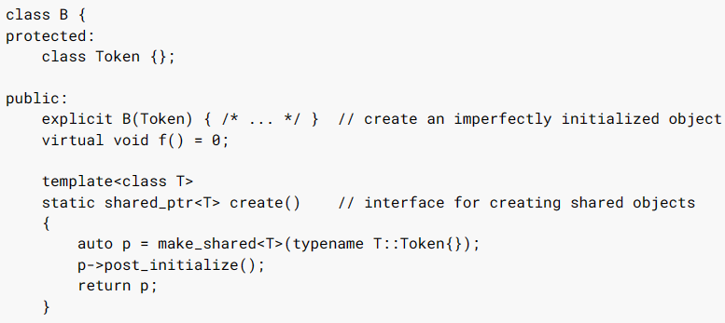
Alternative options

Slide 6
Problem with error codes
Suppress other function’s error codes
Suppress extra information from other function’s errors
Propagate error back
Exceptions and Error Handling, C++ FAQ (isocpp.org)
- Why exception over error code?

Slide 7
Benefits of exceptions
Cleaner, simpler way to propagate error back
Exceptions, when done right, separate the happy path from the error path
Real World code
error propagation
2. handling of the two-return-types problem
Think of exceptions as a separate return type that gets used only when needed

Slide 8
Conclusion
Exception handling is easy and simple!
WRONG!

Slide 9
The benefits outweigh the costs
Requires discipline
Need good team as well: Bad carpenter & Good hammer
Not one-size-fits-all: when to use error codes or exceptions depends
Beware of people blaming new tools (in this case, exception)
https://isocpp.org/wiki/faq/exceptions#exceptions-require-discipline

